Slide 1
Introduction to AI Accreditation

Slide 2
Trustworthiness Requirements
EU High Level Expert Group (HLEG) on AI
Supporting human agency and oversight
Technical robustness and safety
Respecting privacy and allowing data governance
Transparency
Guaranteeing diversity, non-discrimination and fairness
Improving societal and environmental well-being
Accountability for the outcomes of A.I. systems.

Slide 3
Trustworthiness Requirements
US National Institute of Standards and Technology (NIST)
Fairness | Bias is managed
Transparency and Explainability | The system is explainable and the output interpretable
Robustness and Cybersecurity | AI systems can withstand adversarial attacks and maintain confidentiality, integrity, and availability. They are resilient and secure systems
Privacy | The system is developed using privacy-enhancing technologies (PETs) to advance data-driven, innovative solutions to preserve the right to privacy
Source: https://www.nist.gov/speech-testimony/trustworthy-ai-managing-risks-artificial-intelligence

Slide 4
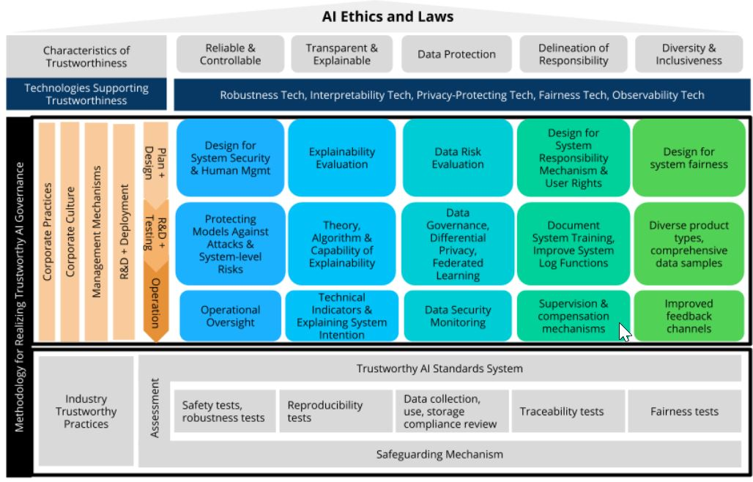
Trustworthiness Requirements
China Academy of Information and Communications Technology (CAICT)
Source: CAICT and JD Exploration Research Institute. White Paper on Trustworthy Artificial Intelligence.

Slide 5
HLEG | NIST | CAICT
Supporting human agency and oversight |  | Operational oversight (as controllability requirement)
Technical robustness and safety | AI systems can withstand adversarial attacks and maintain confidentiality, integrity, and availability. They are resilient and secure systems | AI systems must be reliable and controllable
Respecting privacy and allowing data governance | Use of privacy-enhancing technologies (PETs) to advance data-driven, innovative solutions to preserve the right to privacy | Data Protection
Transparency | System’s explainability and output’s interpretability | Transparency and explainability
Guaranteeing diversity, non-discrimination and fairness | Bias Management | Diversity and Inclusiveness
Improving societal and environmental well-being | Improvement of societal wellbeing as effect of fair system design
Accountability for the outcomes of A.I. systems. | Determinations of accountability for the responsible party in the event that a risky outcome is realized. [AI RMF Draft] | Delineation of responsibility

